Slide 1
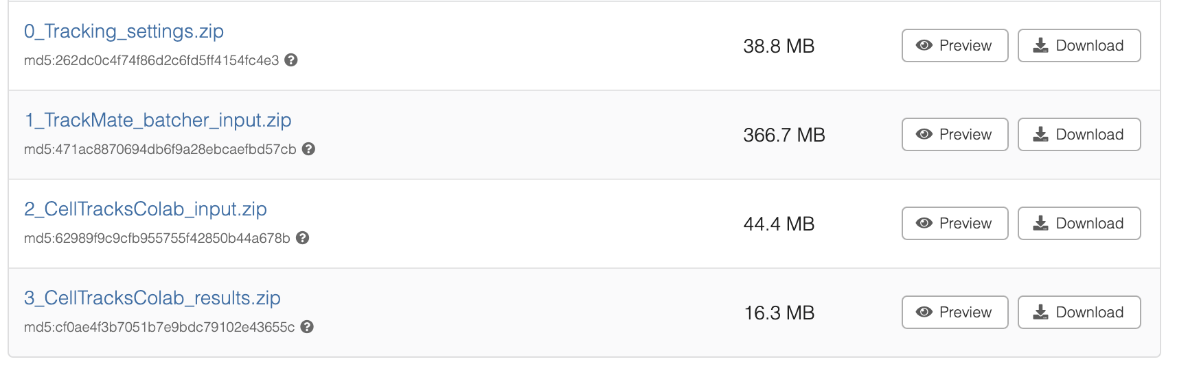
Workshop prep (materials: https://github.com/CellMigrationLab/I2K_2024)
Open Fiji and activate the TrackMate Helper update site. Restart Fiji.
Download
Image for tracking settings
T-cell dataset (TrackMate batcher input)
Tracking results (CellTracksColab input)
Unzip the 2_CellTracksColab_input.zip and upload to your google drive and create a new folder for results.
https://zenodo.org/records/13969009

Slide 2
analysis of cell behavior using TrackMate and CellTracksColab
What, where, how?
Can I also use it?
Joanna Pylvänäinen, joanna.pylvanainen@abo.fi
I2K virtual conference
Materials modified from Guillaume Jacquemet, Hanna Grobe and Robert Haase

Slide 3


Tools developed at Cell migration lab
+
An open-source plugin for Fiji/ImageJ designed for tracking particles and objects
Platform tailored to simplify the exploration and analysis of cell tracking data.

Slide 4
What is TrackMate?
An open-source plugin for Fiji/ImageJ designed for tracking particles and objects in 2D (and 3D) microscopy data.
Key Features:
User-friendly interface with a step-by-step wizard
Flexible: Can handle a variety of biological data (single particles, cells, organelles)
Multiple tracking algorithms: LAP (Linear Assignment Problem), Kalman filter, etc.
Customizable analysis workflows
Visualization and export options for track analysis
Extensive documentation and active community support.
Ershov, D., Phan, M. S., Pylvänäinen, J. W., Rigaud, S. U., Le Blanc, L., Charles-Orszag, A., Conway, J. R. W., Laine, R. F., Roy, N. H., Bonazzi, D., Duménil, G., Jacquemet, G., & Tinevez, J. Y. (2022). TrackMate 7: integrating state-of-the-art segmentation algorithms into tracking pipelines. Nature methods, 19(7), 829–832. https://doi.org/10.1038/s41592-022-01507-1

Slide 5
What is CellTracksColab?
Cloud-based tool for track analysis.
Key Features:
Cloud-based: No installation required; runs on Google Colab notebooks
Accessible: Suitable for users without advanced computing infrastructure
Export and Visualize: Outputs track data, graphs, and visualizations in real-time.
Gómez-de-Mariscal, E., Grobe, H., Pylvänäinen, J. W., Xénard, L., Henriques, R., Tinevez, J. Y., & Jacquemet, G. (2024). CellTracksColab is a platform that enables compilation, analysis, and exploration of cell tracking data. PLoS biology, 22(8), e3002740. https://doi.org/10.1371/journal.pbio.3002740

Slide 6
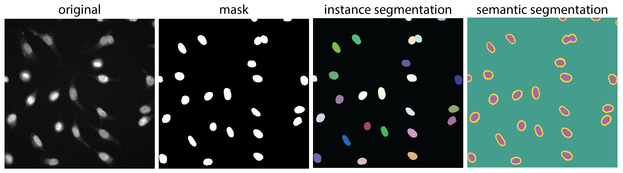
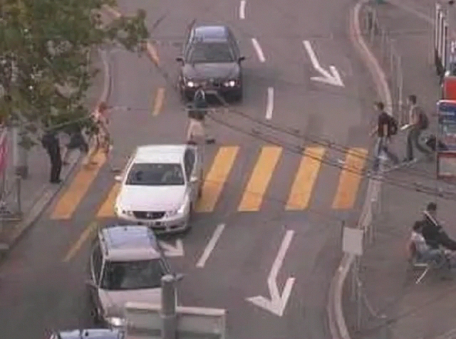



What is Particle and Object Tracking?
Particle tracking
Tracking the centroid of each particle’s signal
Object tracking
Tracking the entire shape and size of the object
Source: Konrad Schindler, Computer Vision Lab, ETH Zuerich
http://www.vision.ee.ethz.ch/datasets/

Slide 7
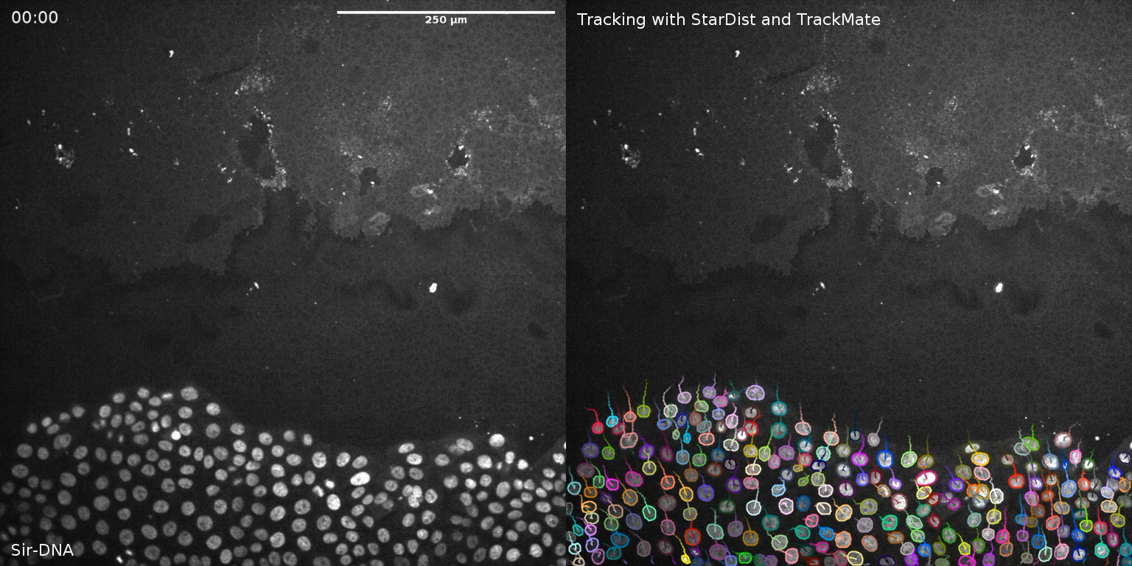
Applications in Cell Biology
Object Tracking:
Tracking individual proteins in live cells
Cell motility and migration studies
Tracking cell division over time
Measuring organelle movement or shape changes over time
Measuring signal changes over time
Ershov et al. (Nature Methods, 2022)

Slide 8
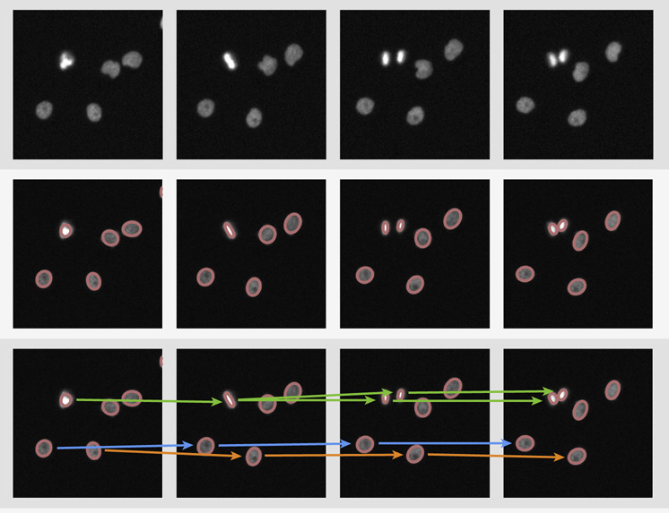
Tracking principle in TrackMate
Inputs
Segmentation
Object Linking
Modified from Tian et al. (Cell Reports, 2010)

Slide 9
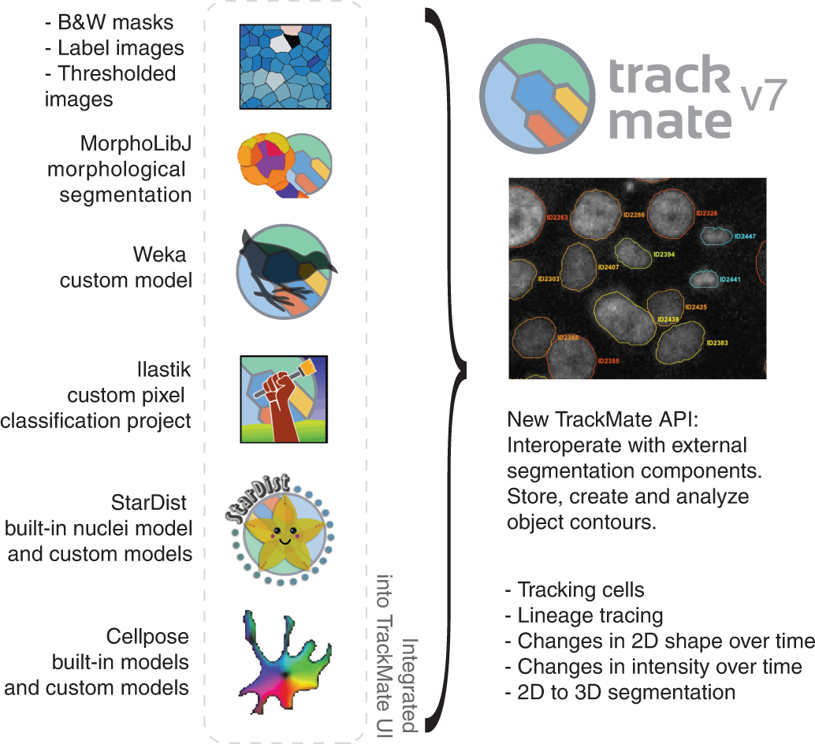
Segmentation
- Intensity-based segmentation
- Feature-based segmentation
- Using a pixel classifier (WEKA, ilastik, ect)
- Using Deep-Learning (e.g. Cellpose, StarDist)

Slide 10
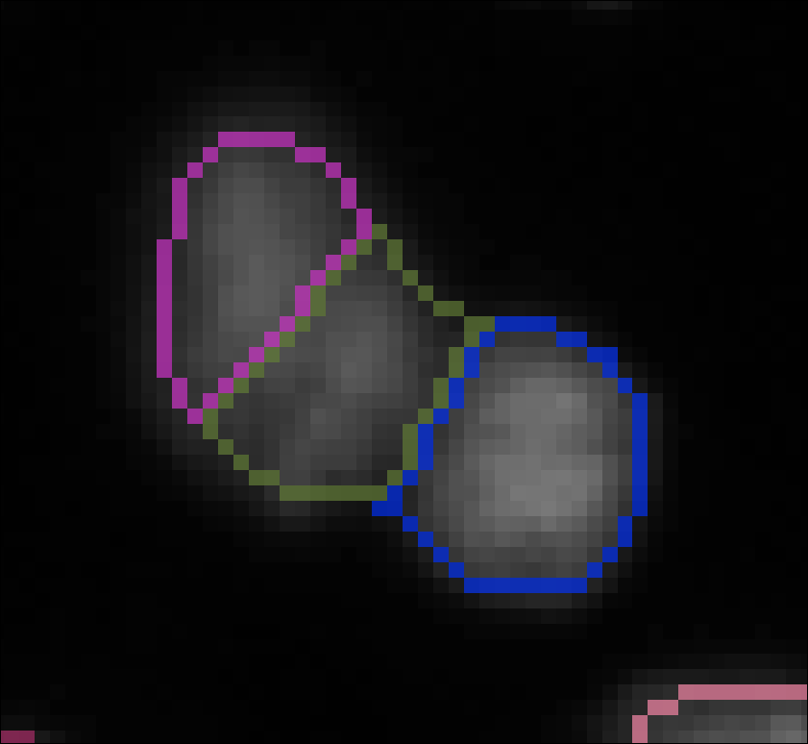
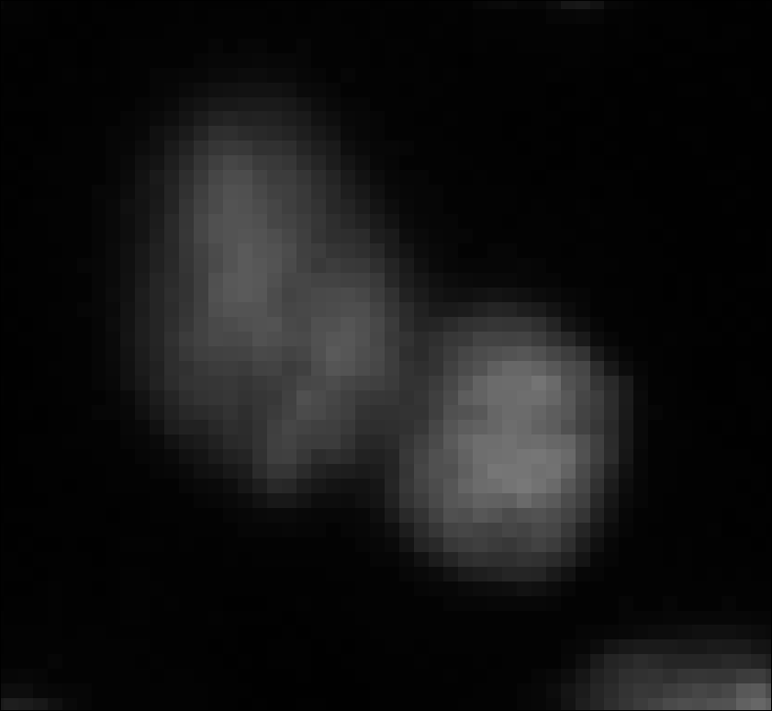
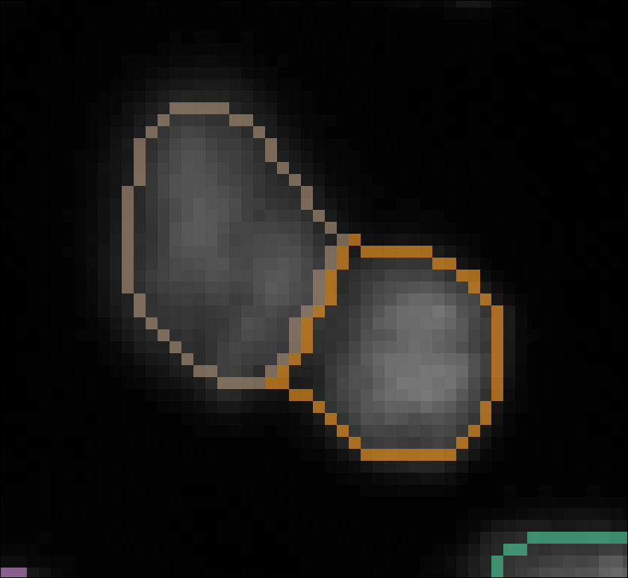
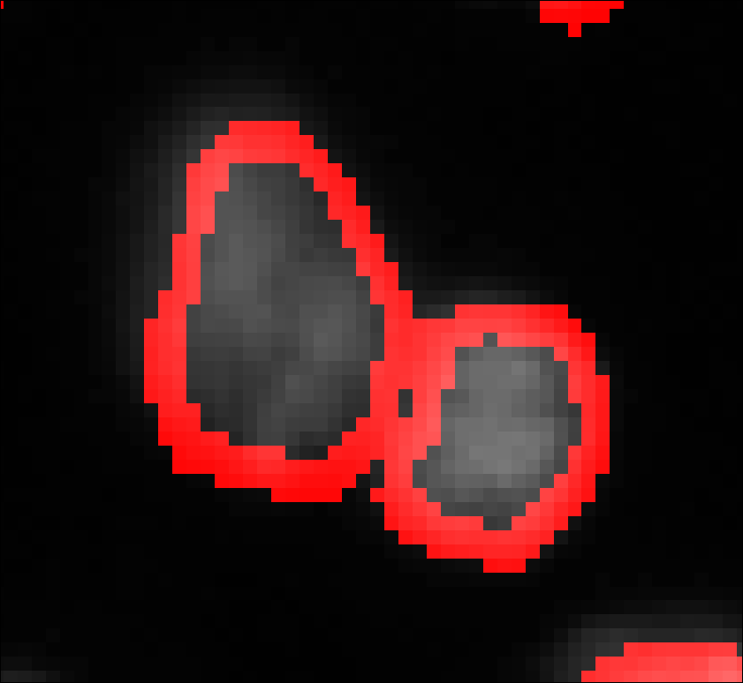
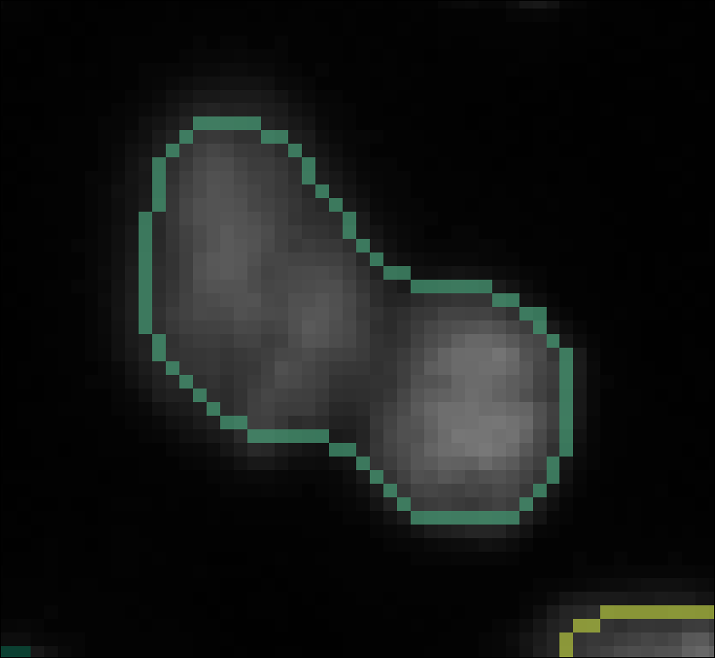
Segmentation
In the tracking context, object differentiation is important
Outline precision can be of secondary interest
False objects
(over-segmentation)
Raw image (nuclei)
Instance segmentation
“Ground truth” (manual annotation)
Image data source: Jones et al., Proc. ICCV Workshop on Computer Vision for Biomedical Image Applications, 2005 / Broad Bioimage Benchmark Collection [Ljosa et al., Nature Methods, 2012, https://bbbc.broadinstitute.org/BBBC007
Missed objects
(under-segmentation)

Slide 11
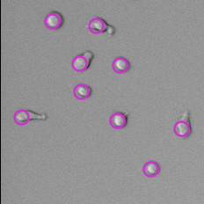
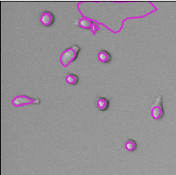
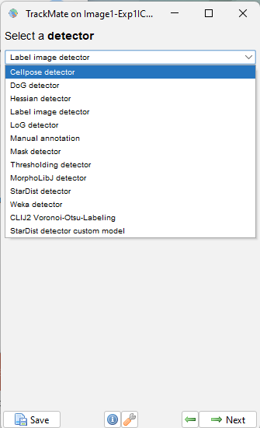
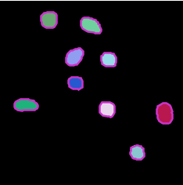
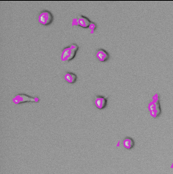
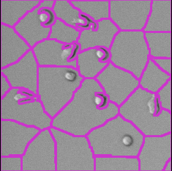
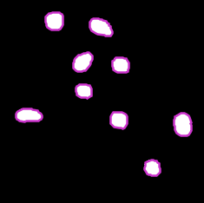
TrackMate object detection
LoG detector
StarDist
Label
Threshold
Voronoi-Otsu
Mask

Slide 12
Tracking principle in TrackMate
Inputs
Segmentation
Object Linking
Trackers are algorithms or tools used to follow the movement of objects over time in a series of images or videos.
Modified from Tian et al. (Cell Reports, 2010)

Slide 13
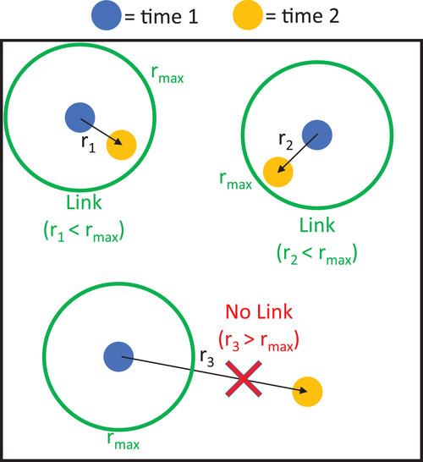
Tracking algorithm example - LAP tracker
Object linking using a search radius (LAP tracker)
Aaron et al. (Current Protocols in Cell Biology, 2019)

Slide 14
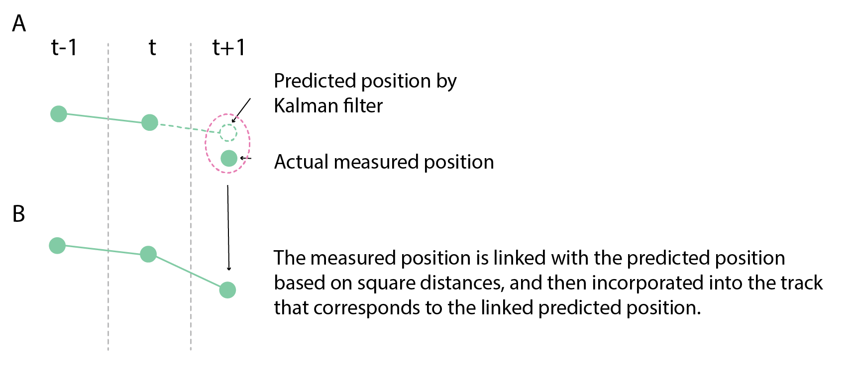
Tracking algorithm example – Kalman tracker
The Kalman tracker is a mathematical tool used to estimate the position of moving objects over time, even when the measurements are noisy or incomplete.

Slide 15
Tracking algorithm example - overlap tracker
Object linking using an overlap (The overlap tracker)
The Overlap tracker is well suited for large objects that move by less than their diameter.
overlap
Link
no overlap
no link

Slide 16
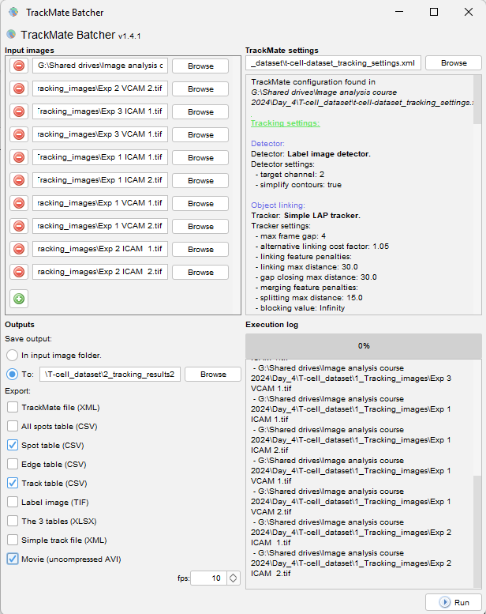
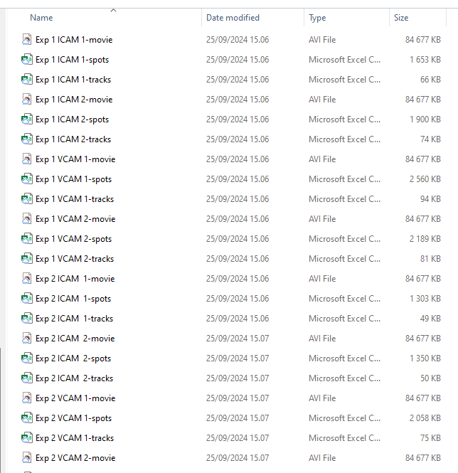
What if you have multiple movies to track?
Output:
Drag and drop the files to track
Path to TrackMate settings file
Export settings
Log window
Trackmate Batcher!!!!!
Start!

Slide 17
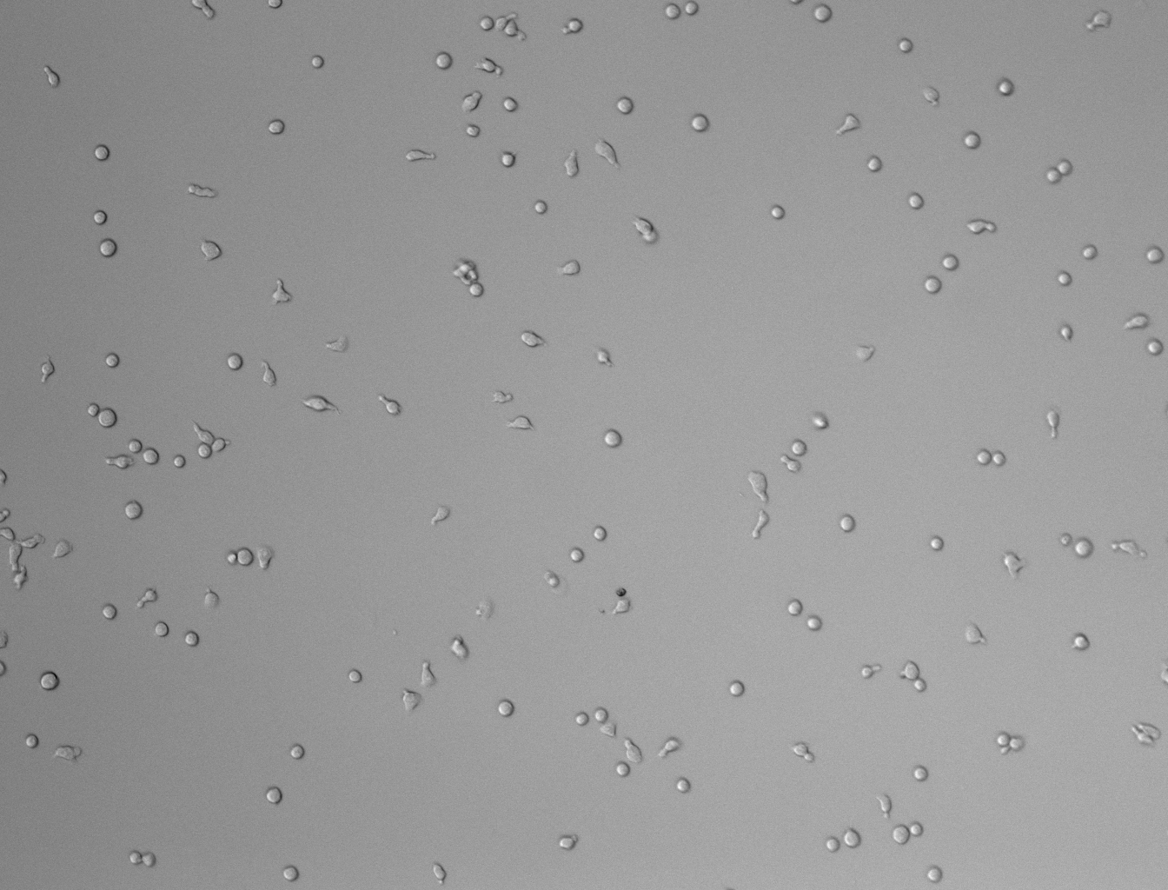
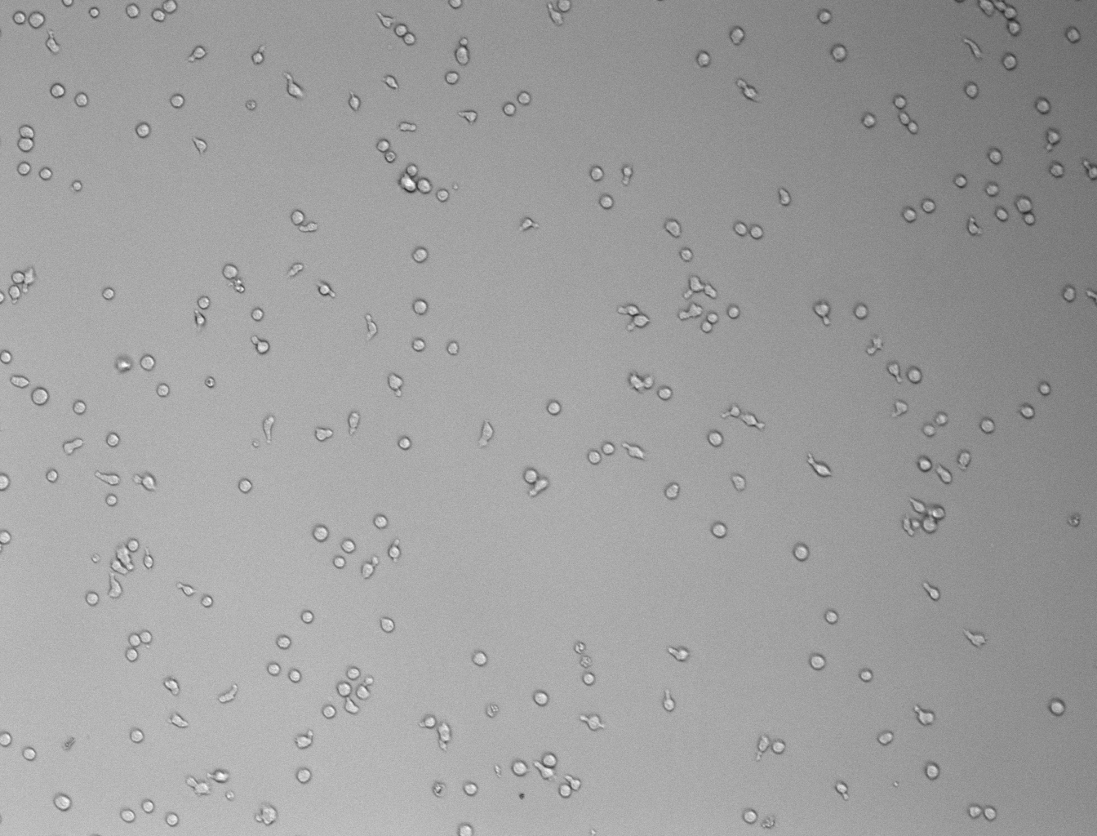
Our task today
How does the coating on glass bottom dishes affect the migration of T-cells?
ICAM
VCAM
T-Cell Dataset Guillaume Jacquemet. (2023). T cell dataset for CellTracksColab - 2 [Data set]. Zenodo. https://doi.org/10.5281/zenodo.8420011

Slide 18
Task 1 – tracking of T cell dataset
Use the Image for tracking settings to define tracking parameters using the TrackMate interface in Fiji
Save these settings as an xml file (TrackMate settings file)
Apply these settings to all data using TrackMate Batcher
Plugins › Tracking › TrackMate Batcher
Folder with the tracking images
Export:
1) Spot table
2) Track table
3) Movie
https://zenodo.org/records/13969009

Slide 19
Track Analysis
Experiments
Datasets
Analysis
Multiple conditions
Multiple repeats
Multiple FOVs
Large number of objects per FOV
Many parameters
Multiple csv files
🤯

Slide 20
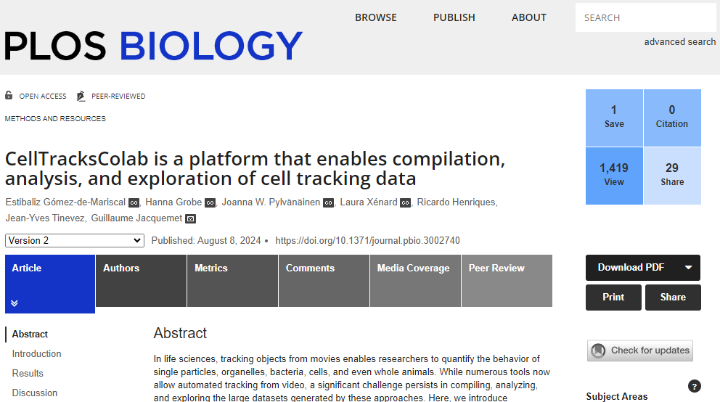
How Do I analyze all this data?
Cloud-based tool for track analysis
CellTracksColab Gómez-de-Mariscal, E., Grobe, H., Pylvänäinen, J. W., Xénard, L., Henriques, R., Tinevez, J. Y., & Jacquemet, G. (2024). CellTracksColab is a platform that enables compilation, analysis, and exploration of cell tracking data. PLoS biology, 22(8), e3002740. https://doi.org/10.1371/journal.pbio.3002740

Slide 21
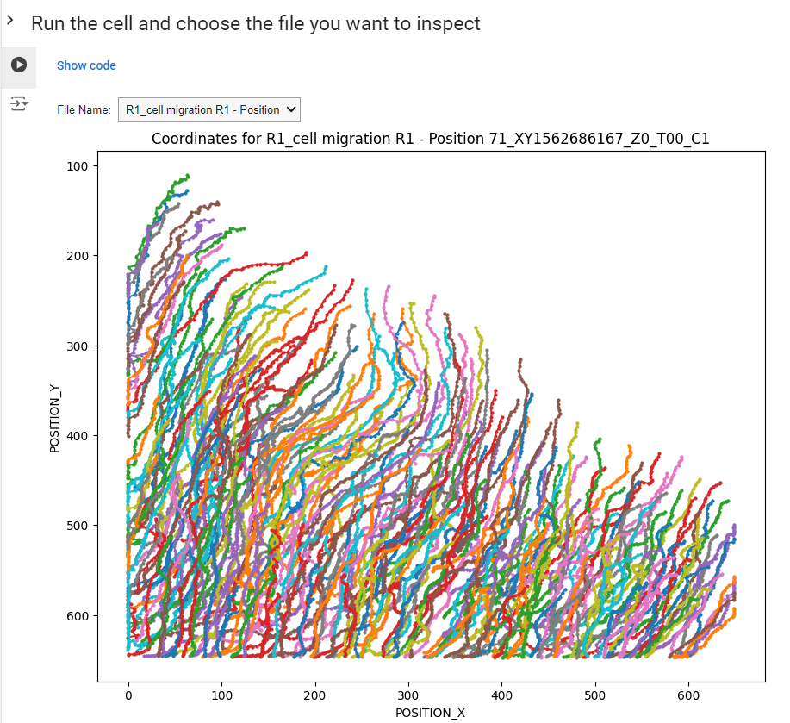
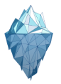
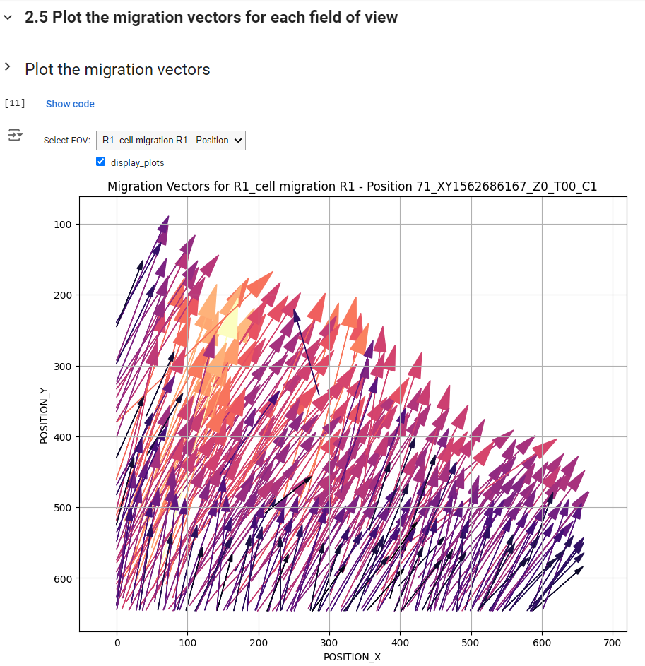


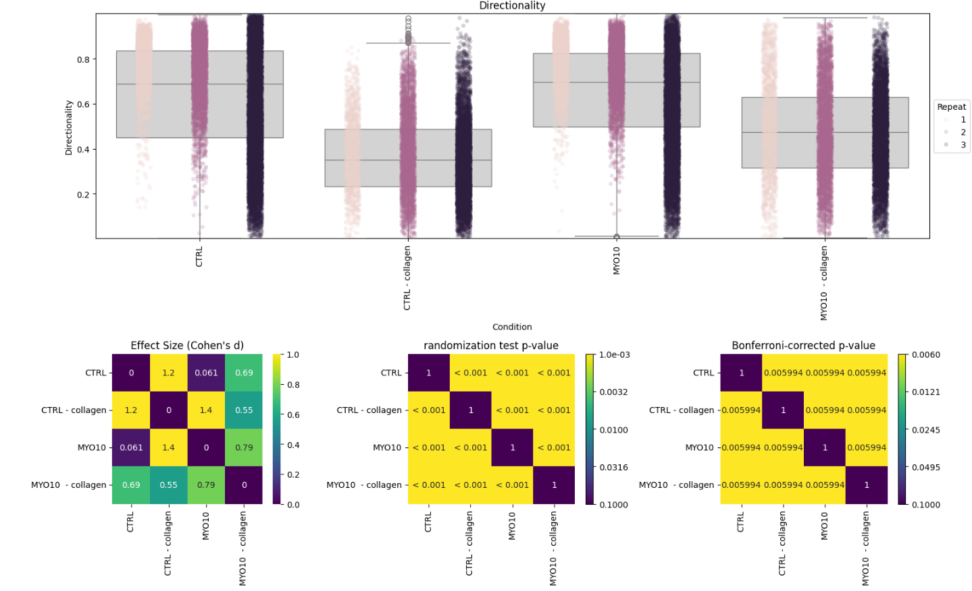


What is CellTracksColab?
Track ID | X | Y | Z | t
0 | 6.8 | 15 | 1.0 | 1
1 | 7.9 | 0.0 | 2.6 | 2
2 | 9.1 | 4.7 | 5.9 | 3
3 | 5.9 | 8.5 | 3.7 | 4
4 | 25 | 3.0 | 6.5 | 5
5 | 67 | 2.4 | 5.1 | 6
6 | 91 | 5.3 | 1.3 | 7
… | … | … | … | …
ICY
FIJI
Ilastik
CellProfiler
TrackMate

Slide 22
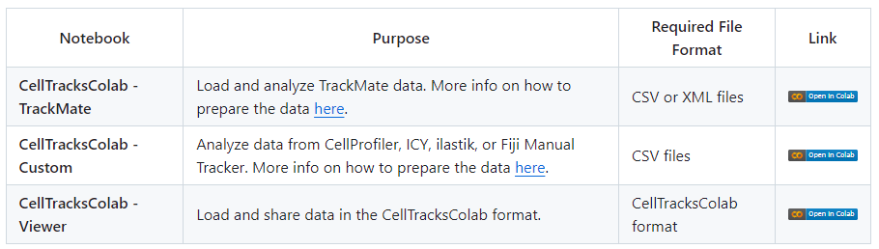
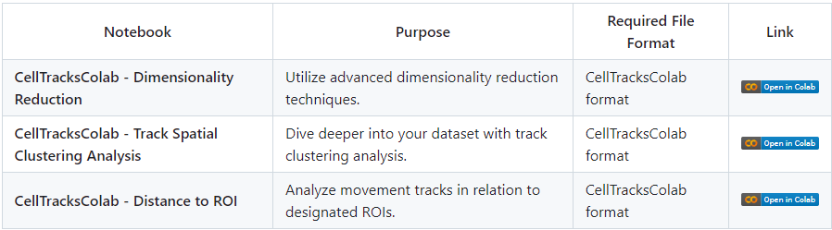
Available notebooks
Simple analysis notebooks
Advanced analysis notebooks

Slide 23




When it runs?
+
Google Colab
Locally using Google Colab
Locally using Jupyter
https://github.com/CellMigrationLab/CellTracksColab

Slide 24
CellTracksColab Workflow
Prepare Data
Load csv files generated from multiple tracking tools
Compiling data
CellTracksColab format
Viewing tracks
Viewing, filtering and smoothing of tracks
Track Analysis
Plotting of conditions, extracting sub-populations

Slide 25
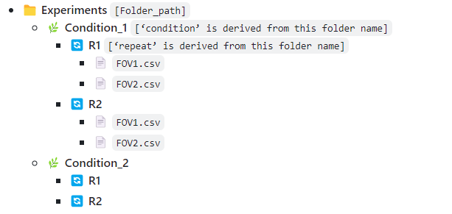
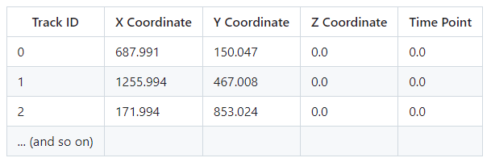
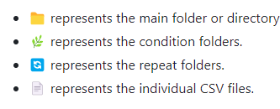
Requirements for CellTracksColab
Minimum requirements for data

Slide 26
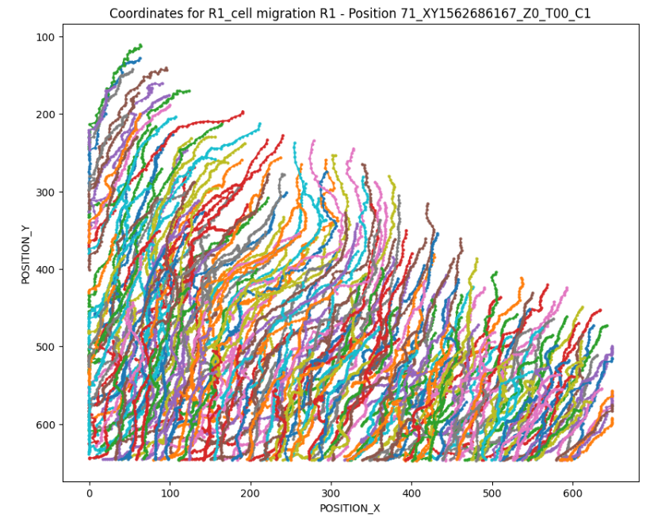
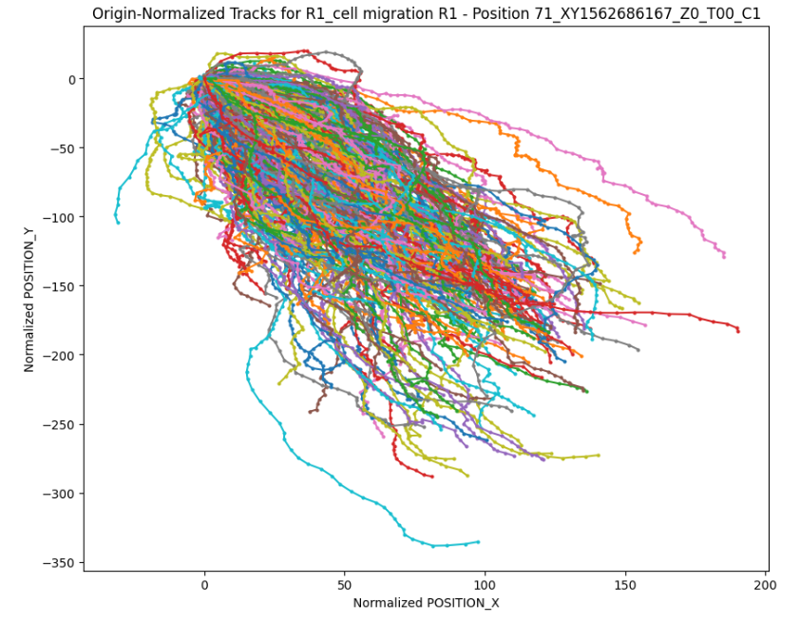
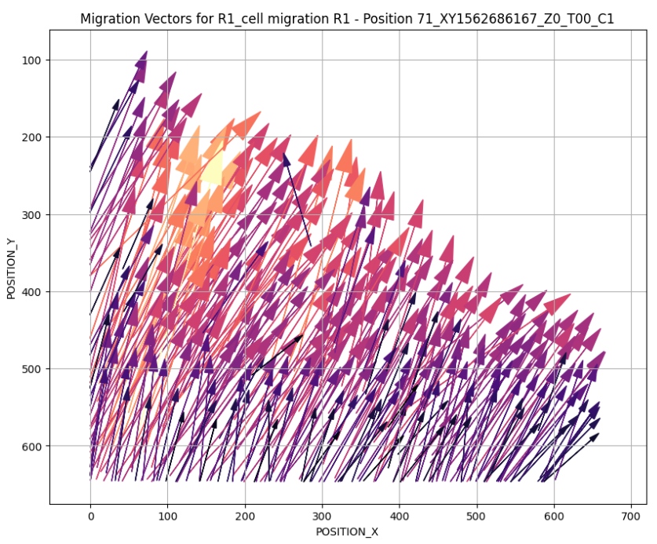
Track Visualization
By repeat
By condition

Slide 27
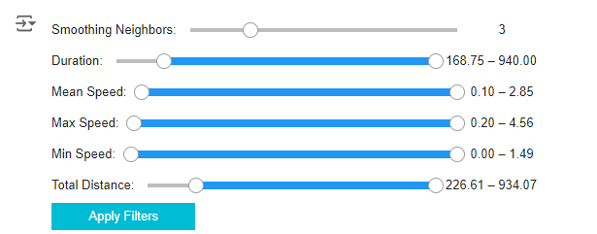
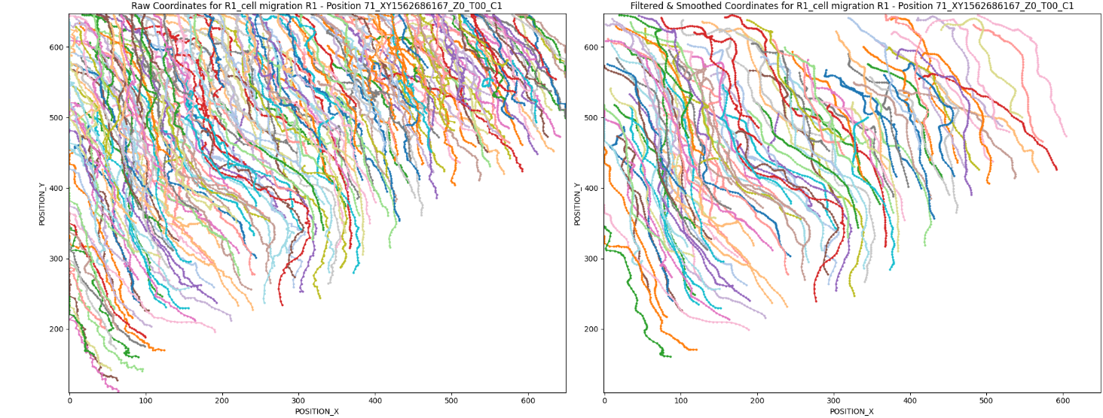
Track filtering

Slide 28
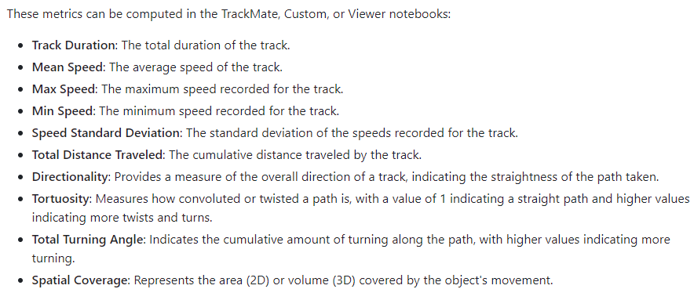
Track features

Slide 29
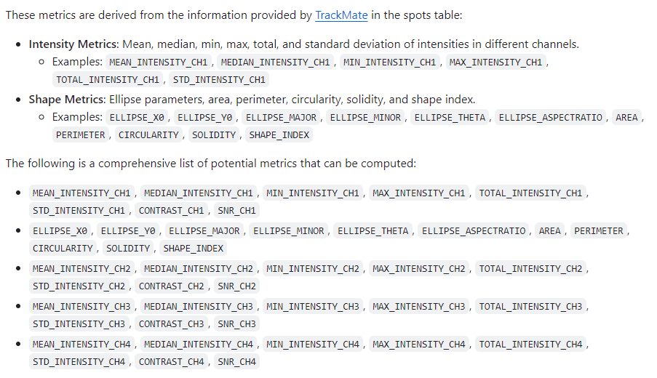
Spot features

Slide 30
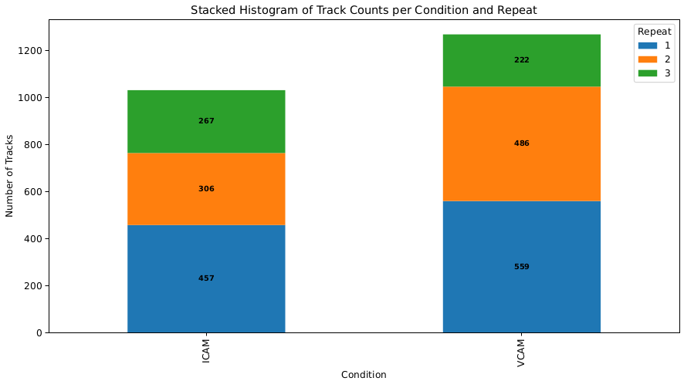
Quality Control
Purpose
Each biological repeat should carry equal weight in the analysis
A balanced dataset is essential for:
Capturing True Biological Variation: Equal weighting ensures accurate representation.
Reducing Sampling Bias: Balancing the dataset helps avoid overemphasizing characteristics from any single repeat, which might not represent the broader biological context.
Note: If your data is imbalanced, consider balancing it to prevent skewing your results.

Slide 31
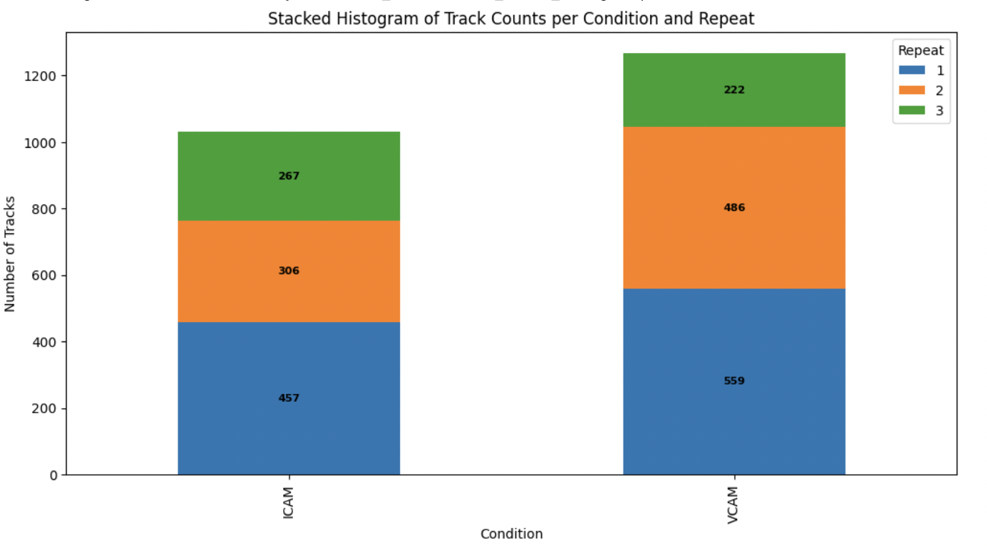
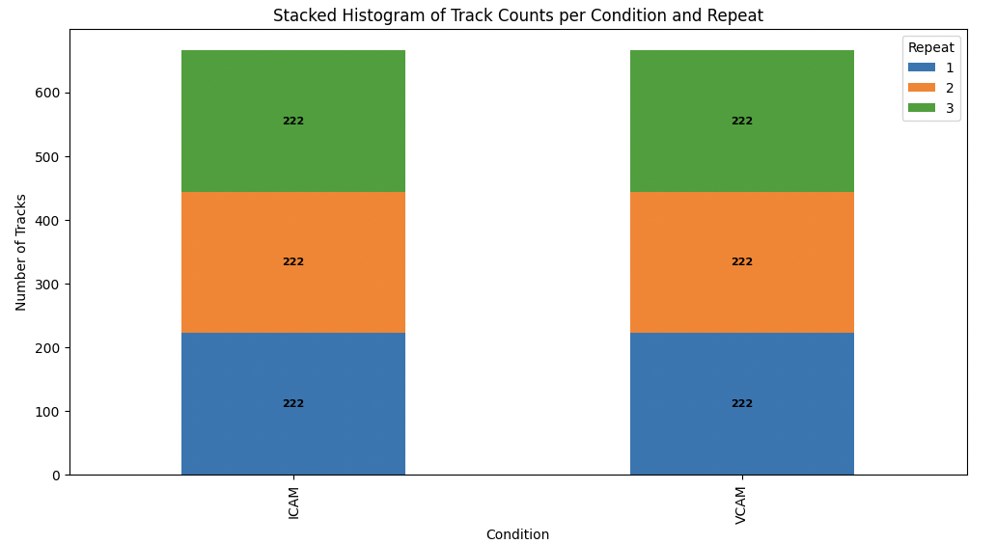
Data balancing
randomly selecting tracks from these larger groups

Slide 32
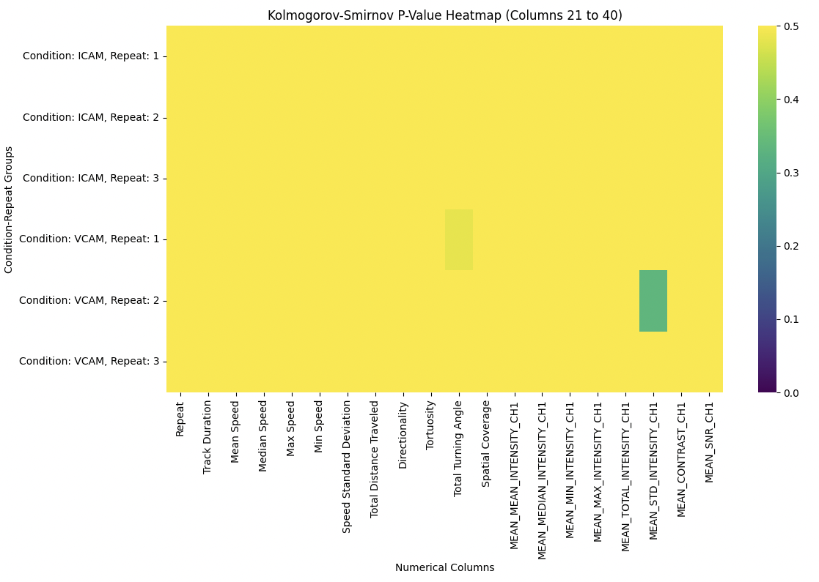
Effect of data balancing
Compares the distribution of each numerical column in the original and resampled datasets to assess if there is a significant change
Presents p-values visually
High P-Values (Yellow):
Down-sampling process likely did not significantly alter the distribution of that numerical column for the specific condition-repeat group.
Low P-Values (Green/blue):
Suggest that the down-sampling process may have affected the distribution significantly.

Slide 33
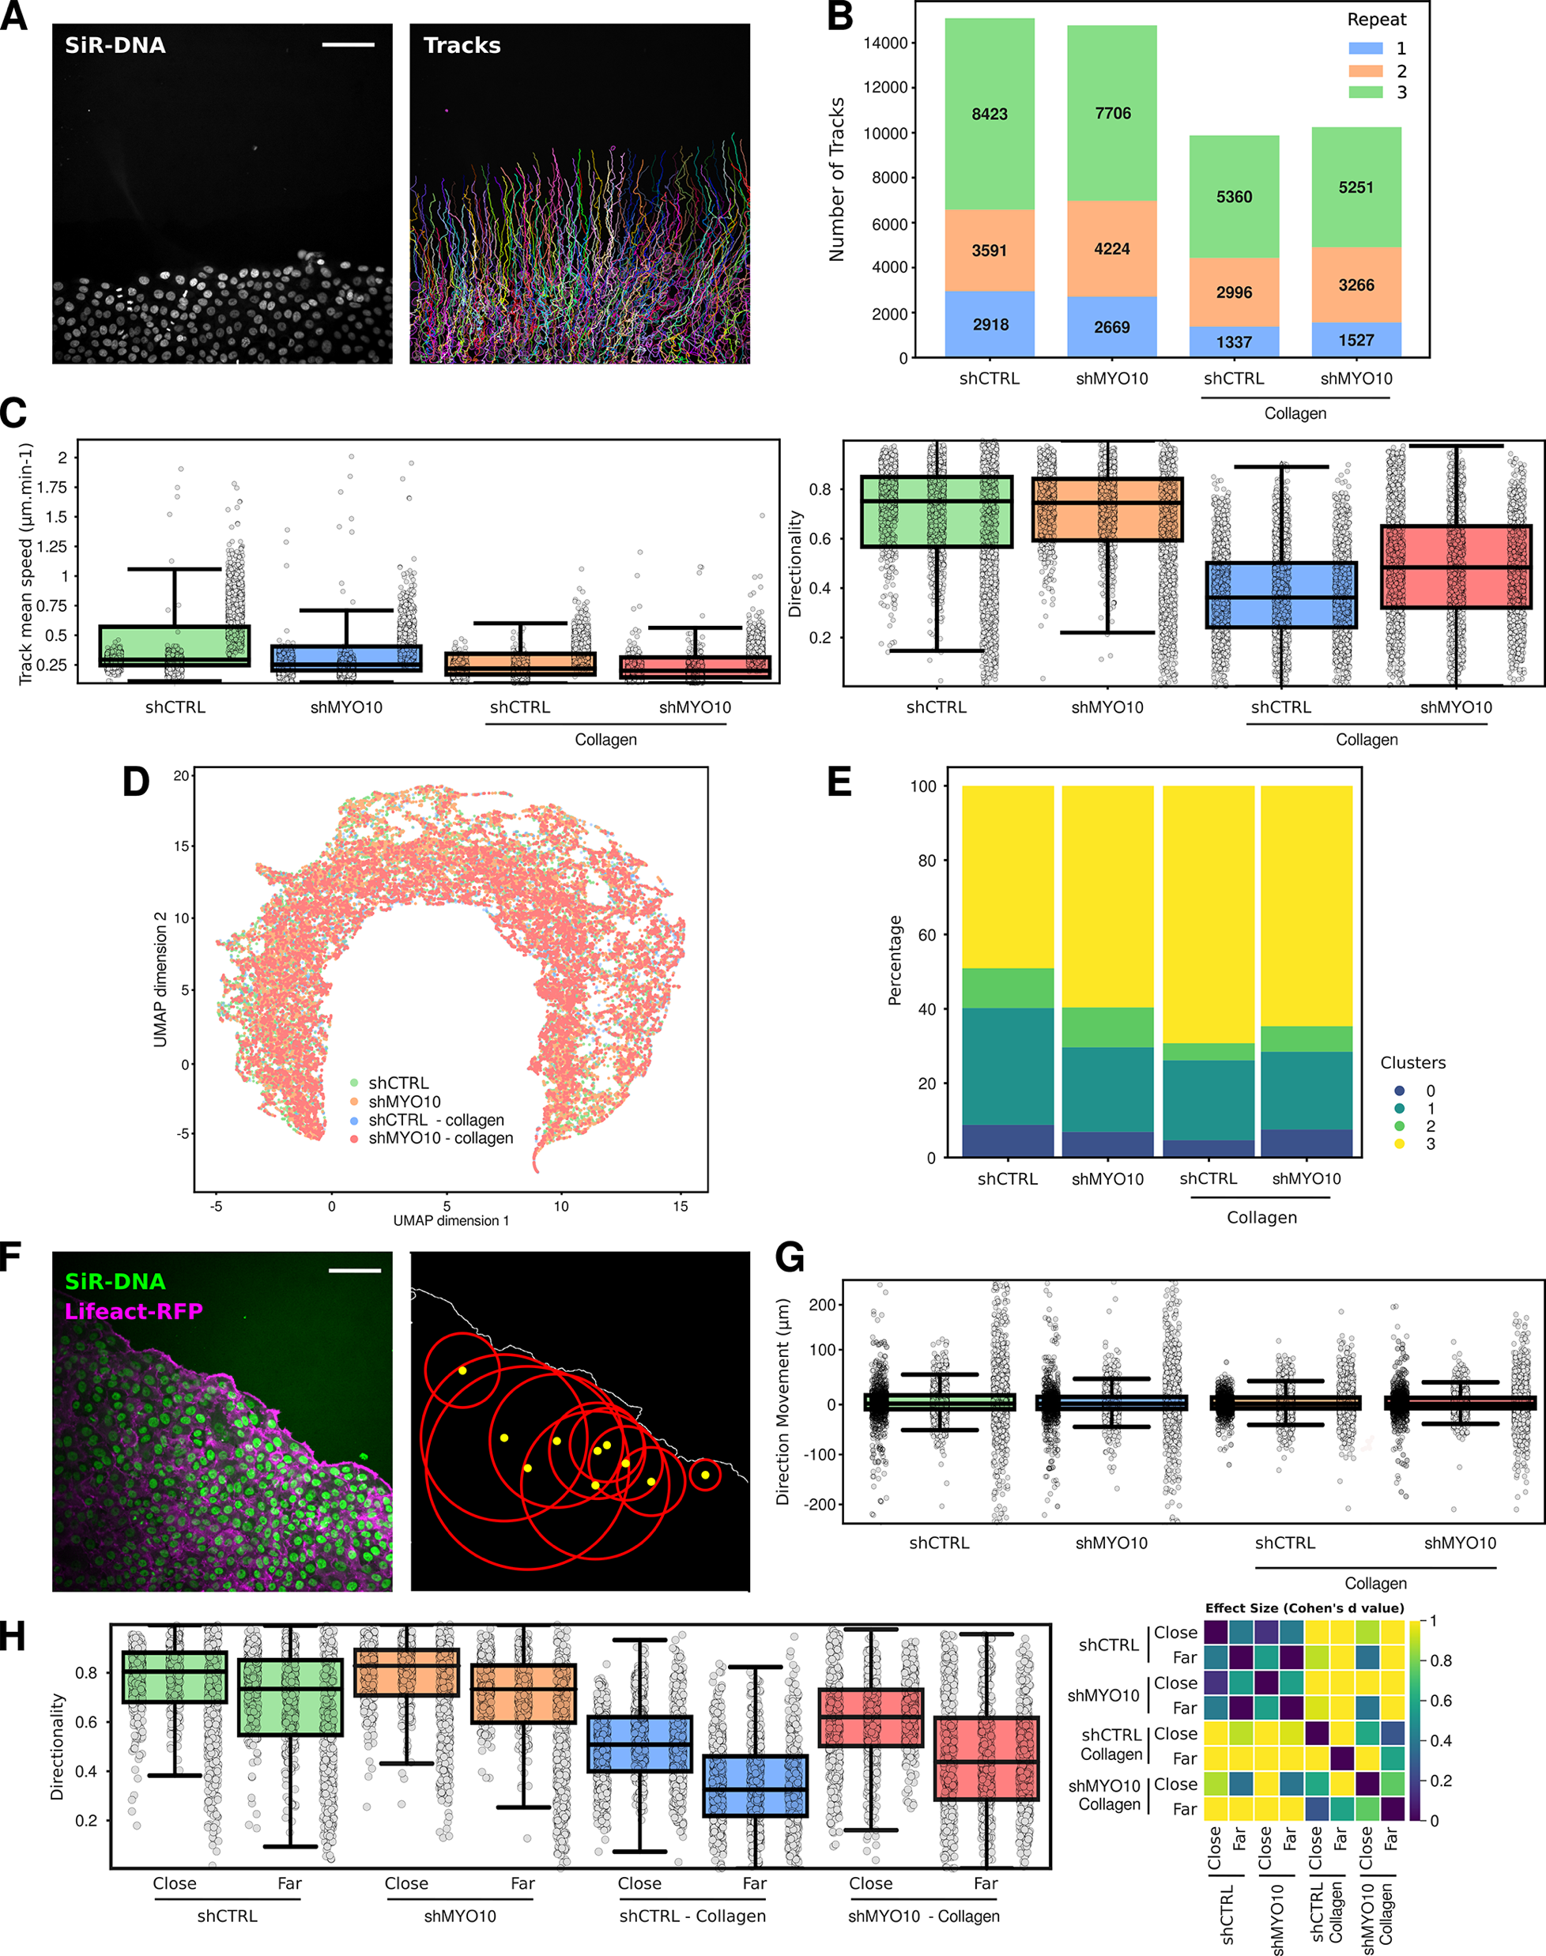
Distance to ROI

Slide 34
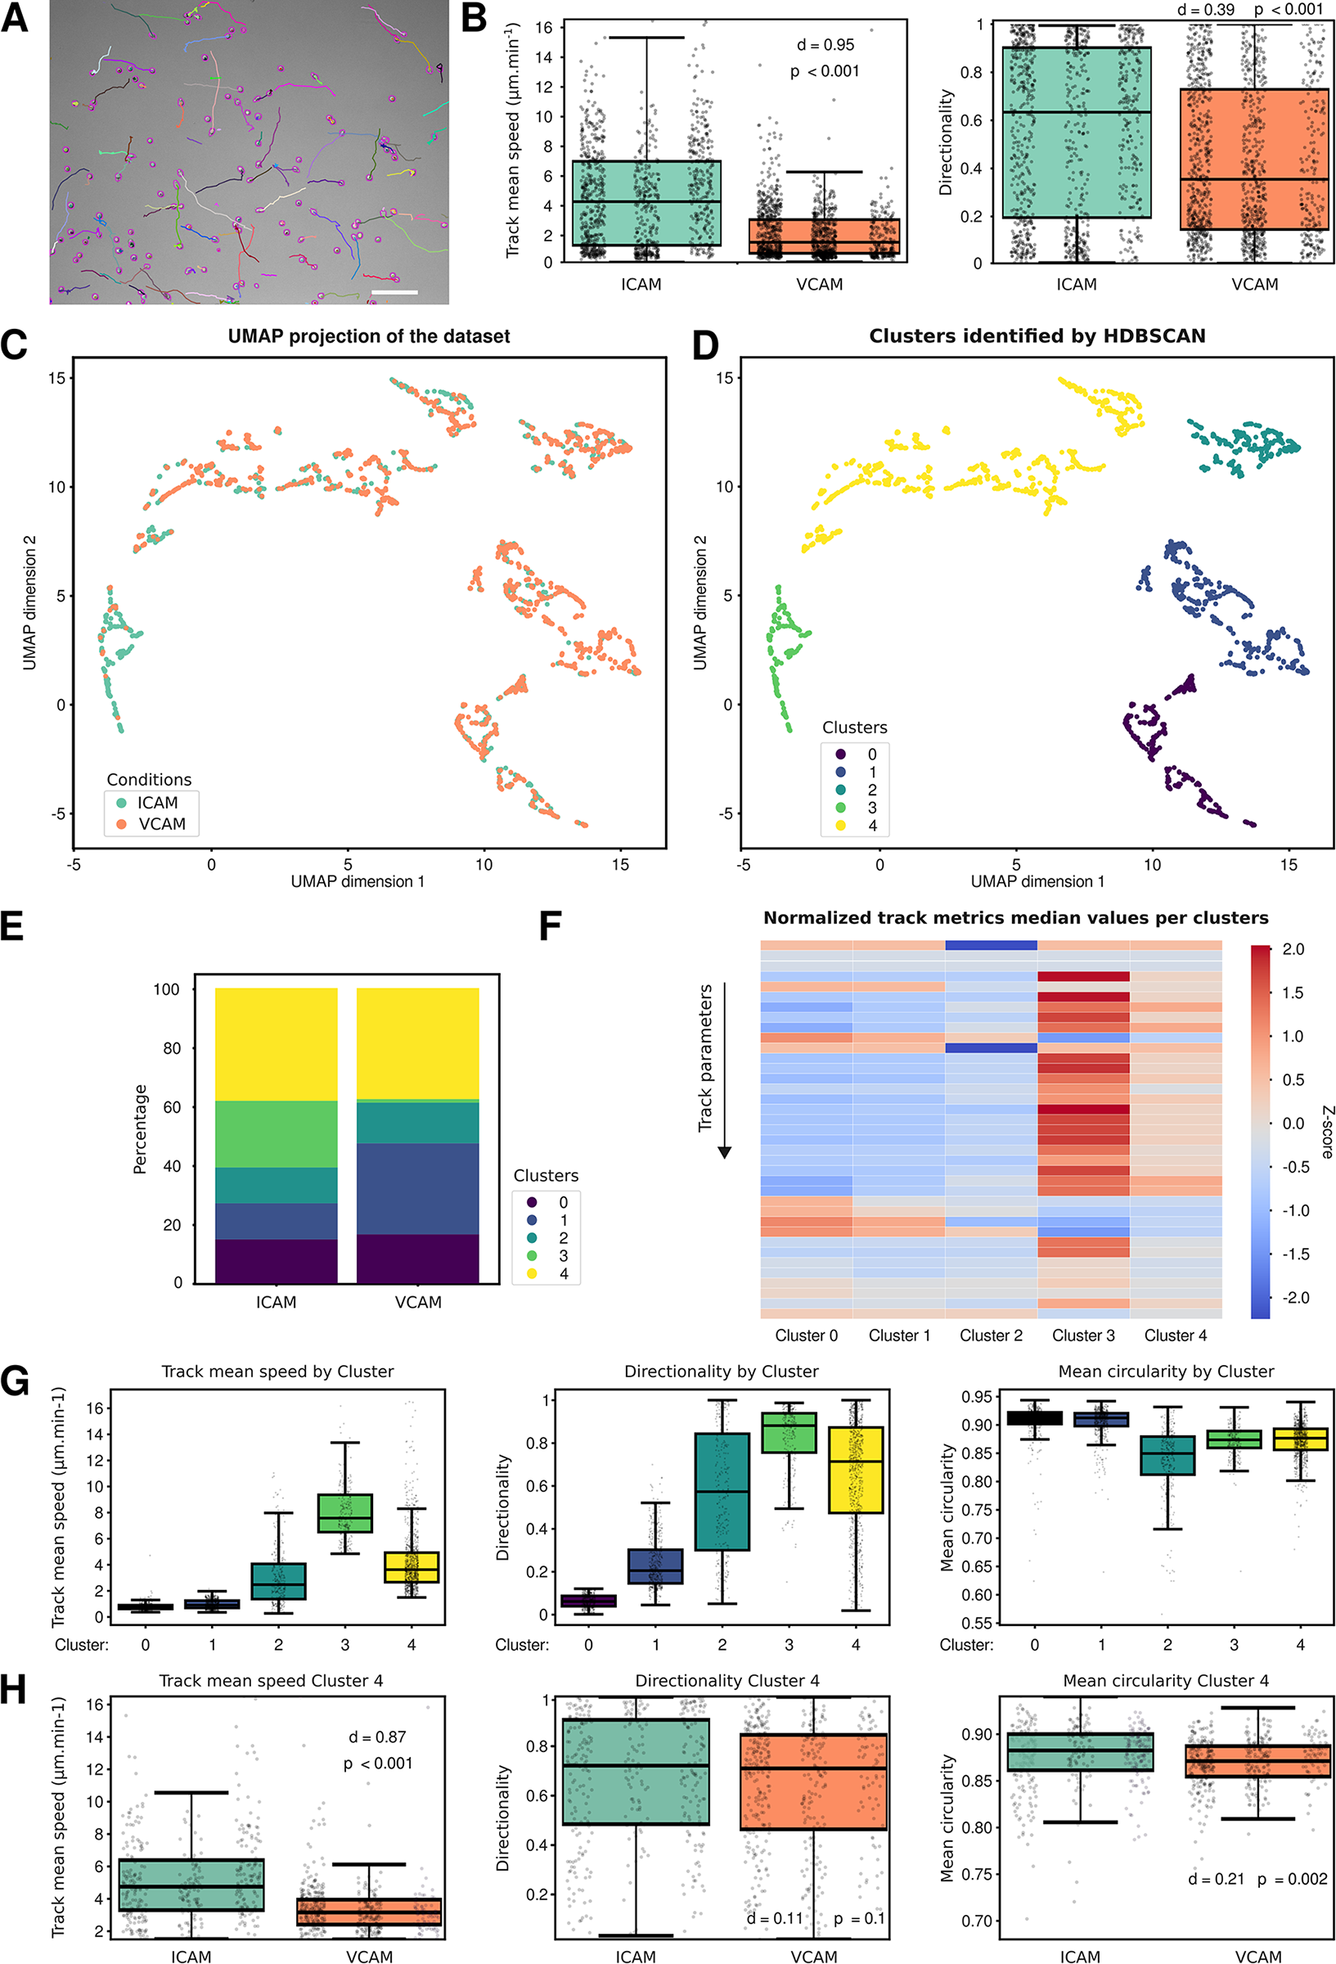
Exploring high‐dimensional data
UMAP and t-SNE:
reducing the number of dimensions of complex data by taking data from its original high-dimensional space and shrink it down to 2D
HDBSCAN clustering data from UMAP/t-SNE output:
determines clusters based on density and similarity, identifying groups of similar cell tracks.

Slide 35
Data fingerprinting and sub-populations
Fingerprinting:
Each cluster represents a group of similar cells or behaviours. Fingerprinting helps create a unique profile for each group.
By cluster
By condition

Slide 36
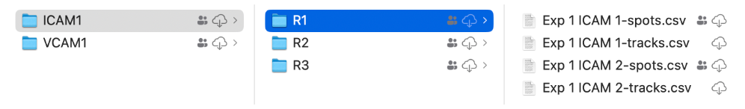
Task 2 – Track analysis using CellTracksColab
Upload your tracking results to your Google Drive (or use the pre-made dataset). Make sure the folders are correctly organized.
Create a folder for results
Open The CellTracksColab TrackMate notebook
Make a copy of the notebook to your drive
Run all cells visualize and generate plots.
https://zenodo.org/records/13969009

Slide 37
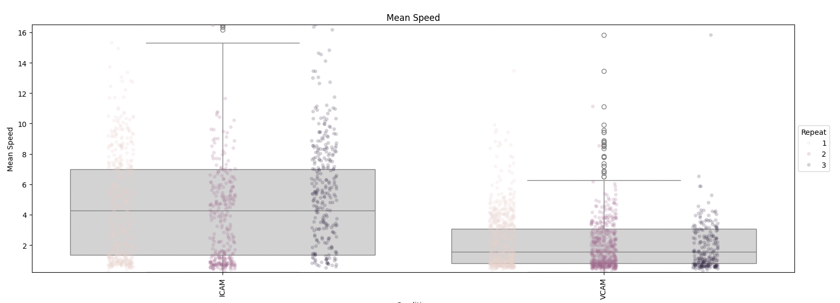
Conclusions
TrackMate and CellTracksColab provide powerful tools for analyzing cell behavior and tracking particles in from large amount of biological data
Allow identification of sub-populations in data and measure their features to better understand the data.

